Slide 1

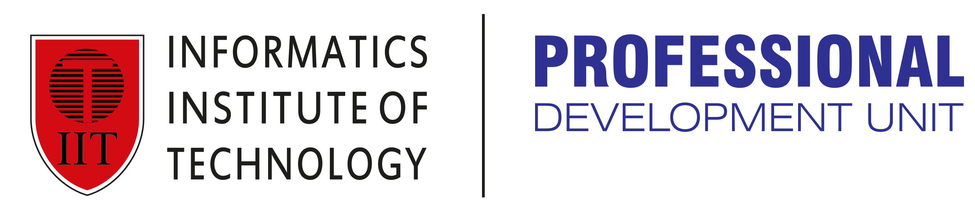
Network & System Administration
System Security

Slide 2
Agenda
Week | 6st Week
Day
Duration | 4hrs
TIME | TOPIC & ACTIVITY | CPMPLETED-
30 Mins | User Authentication and Access Control | Yes/No
60 Mins | Patch Management and Software Updates | Yes/No
15 Mins | Break | Yes/No
45 Mins | Antivirus and anti-malware solutions | Yes/No
30 Mins | Q&A Session on lesson learnt | Yes/No
15 Mins | Break | Yes/No
60 Mins | Incident Response and Recovery | Yes/No
15 Mins | Group Discussion | Yes/No

Slide 3
Learning Objectives
6.1 User authentication and access control
6.2 Patch management and software updates
6.3 Antivirus and anti-malware solutions
6.4 Incident response and recovery

Slide 4
What is System Security?
A crucial task is to maintain a computer system secure. It is a procedure to guarantee the OS's integrity and secrecy. To prevent risks, damaging tasks, attacks, or programs from accessing the computer's software, security is both crucial and essential.
In all cases, a system is considered secure if its resources are used and accessed as intended. However, no system can completely protect against harmful attacks and unauthorized access.
Two infractions may threaten a system's security:
Threat: A program that poses a threat to the system is one that has the capacity for severe harm to it.
Attack: An assault is an effort to breach security and make unauthorized use of an asset.

Slide 5
6.1 User authentication and access control

Slide 6
Introduction for User Authentication
User Authentication is a process in which the identity of any user is verified before they can access anything in your database. It is the process of securing data from unauthorized access. It is important to implement user authentication to prevent data theft, data loss, or network attacks.
There are various methods of data authentication such as multi-factor authentication, password authentication certificate authentication, biometrics token authentication, device authentication API authentication, etc.

Slide 7
Types of User Authentication Methods
The different methods used to identify an authenticated user are referred to as user authentication types. Different types of information that is accessible only to the user and the authentication server may be used by the various methods.
Knowledge base, or something the user knows, includes a username, password, and PINs created by the user.
Possession base, or something the user has, refers to physical devices, including phones and key fobs, or digital assets, such as email accounts.
Biometric base, or something the user is, meaning their biometric data, such as fingerprint scan or face recognition.

Slide 8
What is Multi-Factor Authentication (MFA)?
Alternative to focusing only on a user's login and password, multi-factor authentication (MFA) combines two or more different procedures to confirm the identity of the user. MFA protects businesses against identity theft, cyberattacks, and data breaches by preventing unauthorized access to important applications and data.
Organizations use multi-factor authentication (MFA) for authorizing access to both customer-facing apps and internal IT systems and solutions. MFA is used by financial services firms, insurance companies, healthcare providers, cloud solution providers, and many more in the consumer space to protect their information against fraud, abuse, and data leakage. MFA improves cloud security and enhances the security of conventional inside the premises IT infrastructure.

Slide 9
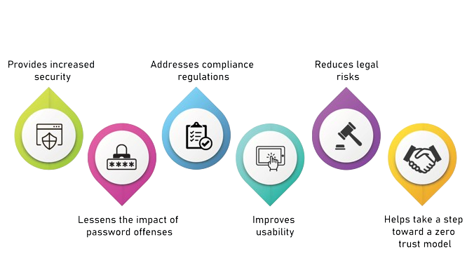
The Benefits of Multi-Factor Authentication (MFA)

Slide 10
6.2 Patch management and software updates

Slide 11
What is Patch Management?
A patch is a piece of code (typically comprised of one or more files) that a software developer develops to update and fix a file or application. Patches are designed to enhance the functionality and resolve issues with computer programs and operating systems. They don't function on Mac computers, but they can be used on Windows and Linux systems.
Types of Patches:
General Distribution Release (GDR): is an update that includes fixes for verified and reported problems.
security-only distribution release (SDR) is made available via Microsoft Update. When applicable, fixes and improvements will be included in the upcoming GDR branch release.

Slide 12
Importance of Patch Management
Fixing Vulnerabilities: Security loopholes that an attacker could exploit are frequently fixed by patches. Patching on time lowers the chance of data theft, security lapses, and other web-based risks.
Enhancing Functionality: Patches can improve system stability and user experience by adding new features, enhancing program performance, or fixing existing weaknesses.
Compliance: Keeping systems up to date is mandated by regulations in several businesses. Organizations can adhere to these rules with the use of efficient patch management.
Risk management: Patch management helps to mitigate a variety of operational and security risks by lowering vulnerabilities and enhancing system performance.
Cost-effectiveness: Proactively addressing problems with patches helps avert more serious ones that could necessitate costly solutions or result in downtime.

Slide 13
Type of Patches
Bug Fix Patches: Address specific bugs or issues within software.
Security Patches: Fix security vulnerabilities.
Feature Patches: Add new features or improve existing ones.
Performance Patches: Enhance the performance of software.
Tools for Patch Management
WSUS (Windows Server Update Services)
SCCM (System Center Configuration Manager)
Third-party tools (e.g., SolarWinds, ManageEngine)

Slide 14
Challenges in Patch Management
Compatibility issues
Downtime and disruption
Keeping track of patches
Best Practices for Patch Management
Effective Strategies
Regular patch schedules
Automated patch management systems
Backup and restore plans

Slide 15
6.3 Antivirus and anti-malware solutions

Slide 16
Definitions of Viruses and Malware
Viruses:
A computer virus is a kind of malicious software (malware) that spreads by injecting a copy of itself into data files, other computer programs, or the hard drive's boot sector when it is executed. Upon successful replication, the impacted regions are referred to be "infected." Viruses frequently destroy data, interfere with system functions, and spread to other systems and harm the host device.
Malware:
Any software that is purposefully created to harm a computer, server, client, or computer network is referred to as malware, short for malicious software. Malware can be found in other applications, scripts, code, and active content. Malware can take many different forms, including as worms, Trojan horses, spyware, adware, ransomware, and more.

Slide 17
Benefits of a VPN (Virtual Private Network).
1. Secure Remote Access:
Virtual Private Networks (VPNs) allow users to safely access to a private network from a distance. This feature is particularly helpful for companies that have workers that work remotely. This guarantees that private information sent over the internet is protected from attackers and suspicious parties.
2. Cost-effective:
By utilizing a VPN, businesses can cut reduce the expenses related to setting up and keeping up private, physical networks. They can establish a private, secure communication channel using the current internet infrastructure in place of dedicated leased lines. Businesses with numerous remote offices or personnel that travel regularly will find this to be especially helpful.

Slide 18
Types of Malware
Virus: A parasite that clings to uncontaminated files and spreads to other files, frequently corrupting data and software.
Worm: Without attaching to files, worms spread over networks by taking advantage of security holes.
Trojan Horse: Poses as a trustworthy application to trick users into running it; frequently, it opens backdoors to allow illegal access.
Ransomware: encrypts information and requests money for the key to unlock it.
Spyware: Covertly observes user behavior, gathering information about browsing patterns, keystrokes, and personal data.
Adware: Software that downloads or automatically shows advertisements, frequently without the user's permission.
Rootkit: Grants elevated access to a computer while concealing its existence and that of additional malevolent processes.

Slide 19
Anti Malware and Antivirus Solutions
Signature-based scanning. This is the fundamental method that all antimalware programs—free and paid ones alike—use. A database of recognized viral signatures is necessary for signature-based scanners. The recentness of the signatures in the database determines how well the scanner performs.
Heuristic analysis. By comparing viruses to one another, this finds similar viruses. Instead, then looking at the complete signature, it looks at portions of the malware's essential code. A virus can be found via heuristic scanning even if it is concealed by extra junk code.
Real-time behavioral monitoring solutions. These look for unforeseen activities, like gigabytes of data being sent across the network by an application. It stops the activity and looks for the malware that is causing it. This method works well for finding malware without files.

Slide 20
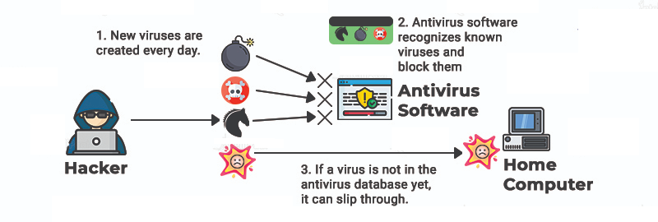
Anti Malware and Antivirus Solutions
Sandbox analysis. This transfers suspicious files to a secured environment, such as a sandbox, so that they can be activated and examined without endangering the network.

Slide 21
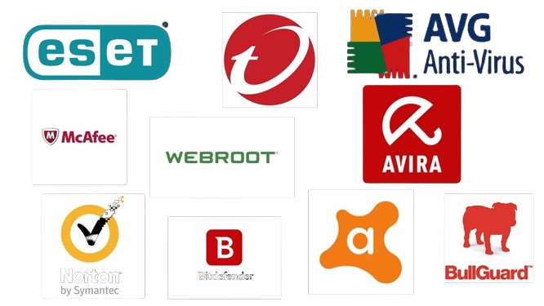
Popular Anti Malware Software’s Available

Slide 22
Q&Q Session on Lesson learned

Slide 23
Q&Q Session
Q1: What is multi-factor authentication (MFA) and why is it important?
A1: Multi-factor authentication (MFA) is a security system that requires more than one method of authentication from independent categories of credentials to verify the user’s identity for a login or other transaction. MFA is important because it significantly enhances security by requiring multiple forms of verification, which reduces the risk of unauthorized access..
Q2: What are some common biometric authentication methods?
A2: Common biometric authentication methods include fingerprint recognition, facial recognition, iris scanning, voice recognition, and retinal scanning. These methods use unique biological characteristics of individuals to verify their identity.
Q3: What is the primary goal of patch management?
A3: The primary goal of patch management is to ensure that all software systems are up-to-date with the latest patches, which fix security vulnerabilities, bugs, and add new features. This helps to protect systems from security threats and maintain optimal performance.

Slide 24
Q&Q Session
Q4: What is a security patch, and how does it differ from other types of patches?
A4: A security patch is an update specifically designed to fix vulnerabilities that could be exploited by attackers. It differs from other types of patches, such as bug fixes (which address software bugs) and feature updates (which add or enhance functionalities).
Q5: How does signature-based detection work in antivirus software?
A5: Signature-based detection works by scanning files and comparing their contents against a database of known malware signatures. If a match is found, the software identifies the file as malicious. This method relies on a continually updated database of malware signatures.

Slide 25
6.4 Incident response and recovery

Slide 26
What Is Incident Response?
An incident is a situation or abnormality that could have an adverse impact on the business, customer information, essential assets, and ultimately, business operations. An incident might be man-made (cyberattacks) or natural (damage caused by an earthquake, for example). Incidents can range from corporate espionage to natural disasters and security breaches. An incident reaction is a series of actions intended to be initiated upon detection of an incident. Although it outlines a step-by-step plan for responding to an incident if all security defenses fail, it is not a preventive measure.

Slide 27
Preparation of Components on an Incident Response Plan
The process for identifying what an incident means for the organization involves assessing the probability of an occurrence being as well as the potential financial, legal, and reputational harm that it might create.
Detailed guidelines that must be followed in each case that arises.
a list of the participants along with their contact information.
a list of instruments to be employed in the attack's mitigation. These can include network tools, anti-malware software, forensic software, USB devices with backups, and hard drives with drive images copied.
a communication strategy to be implemented both inside the company and with customers and the public.

Slide 28
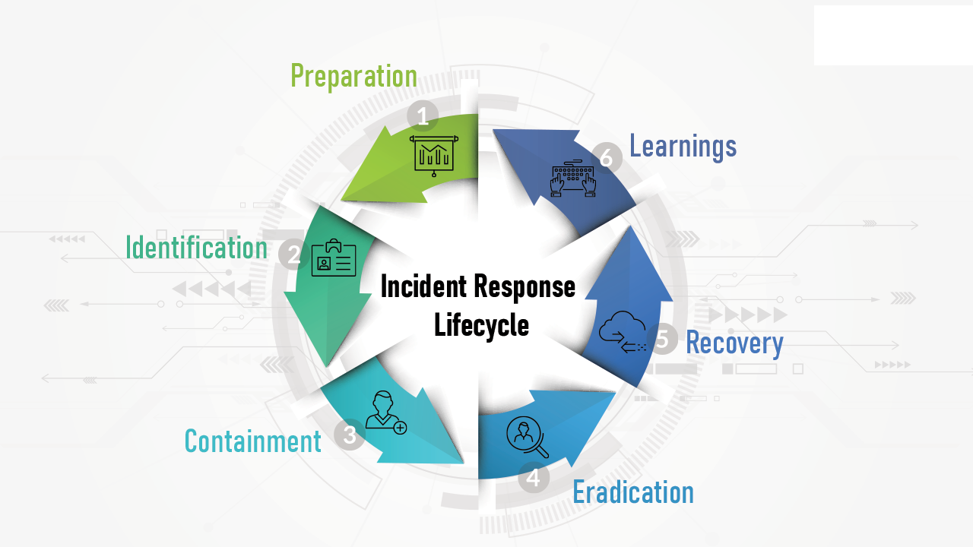
Lifecycle of an Incident Response

Slide 29
Example: Process of Incident Response
Form a special incident response team.
Determine the essential resources and elements.
Make the plan for responding to incidents.
All staff members should receive training.
Determine which factor led to the occurrence.
Limit, intensify, or eliminate.
Assess the damage.
Communicate to each other.
Recover and monitor.

Slide 30
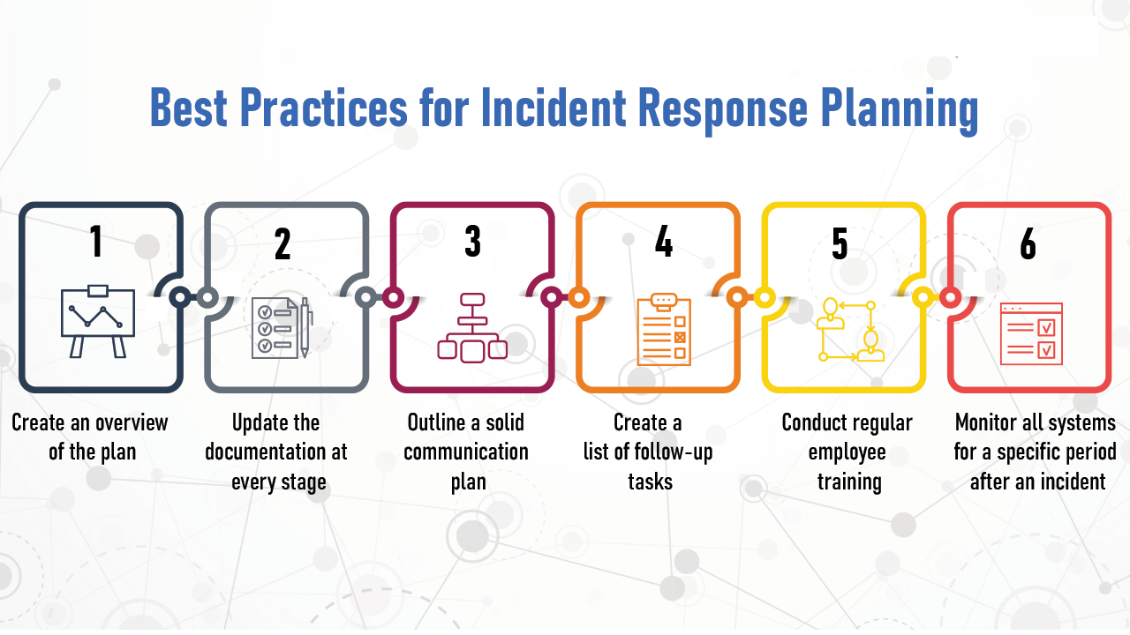
Example: Best Practices for Incident Response Planning

Slide 31
Group Discussion
What are the network devices and how to configure.
What is VLANs what the use of Trunking.
What is Virtual Private Networks (VPNs)
What the use of Wireless Network.

